Slide 1
Return of the Greeps

Slide 2
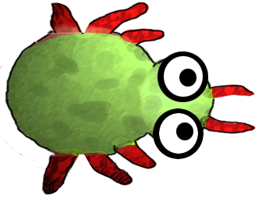
Return of the Greeps

Slide 3
Return of the Greeps
CS18010
Team Members:
Tomos Fearn
Kamil Cupial
Ashley Evans
Sorres Arslan

Slide 4
Temporary Page for Content
GitHub, what it is, how it works, how you found using it
GreenFoot, what it is
Greeps, the modifications you made, the experience had
Demo of greeps
The experience of working in a group

Slide 5
GitHub
GitHub, what it is, how it works, how you found using it
What is it?
How does it work?
How did we find using it?

Slide 6
GreenFoot
What is GreenFoot?

Slide 7
Evolution of our Greeps…
What are the modifications we have made to the Greeps?
The experience we’ve had doing it.

Slide 8
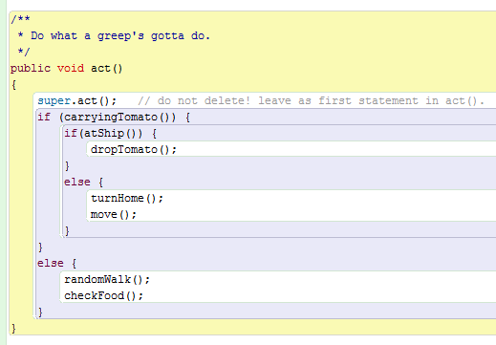
Our Basic Structure
Greeps are born very stupid and understand very little…
3 basic situations
If the Greep is carrying a tomato then run turnHome() and move().
If the Greep has arrived at the ship (Home) then drop the tomato.
Else wonder about looking for tomatoes.

Slide 9
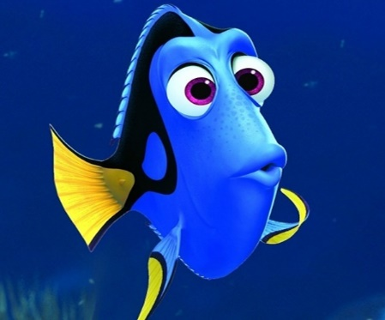
Our Main Problems
?
The memory of the Greeps were one of the biggest problems during the project
Problem:
Greeps can only remember 1 location at a time.
Solution:
Every time a Greep returns to the Ship it reads the memory bank from the ship where locations of the piles of tomatoes are known
Greeps are forgetfull
?

Slide 10

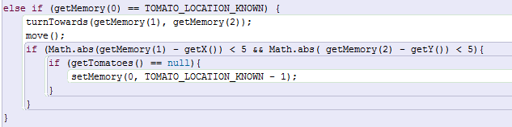
Our Main Problems
?
The invisible tomatoes
Problem:
Greeps return to the location where they found tomatoes and then stay there even when there are no tomatoes left.
Solution:
If the greep returns to its location where it knows the tomatoes are, but there are null tomatoes (wipe memory?) and RandomWalk.
These tomatoes don’t have an invisibility cloak, the Greeps just return to the location where they last found a tomato even when there are none left in the location.

Slide 11
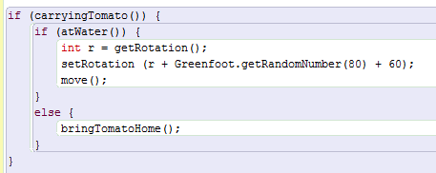
Our Main Problems
Water is an obstacle. Engage the Greep Jiggle!
Problem:
As our Greeps were on their way back to the ship they would get stuck at the water.
Solution:
We make the Greeps Jiggle their way around the water obstacle.
Our Greeps dance out of trouble…

Slide 12
The Demo
Our Demo!

Slide 13
Our Teamwork
How was the experience of working in a group?

